Slide 1
Web Server
Mir-lab

Slide 2
Index
What to do?
Overview
What is WebServer?
How do you make Multithread Webserver?
WebServer in JAVA
Port forwarding
Protocol conformance testing tool
DEMO
Appendix (Java & Eclipse Install) – Window, Linux
Notes:
Mission 1: WEB SERVER SOCKET
Mission 2: GET METHOD
Mission 3: STATUS CODE : 200OK
Mission 4: STATUS CODE : 404 NOT FOUND(EXCEPTION HANDLING)
Mission 5: STATUS CODE : 400 BAD REQUEST(HTTP PROTOCOL VERSION )
Mission 6: CONTENT LENGTH
Mission 7: CONTENT TYPE TEXT/HTML
Mission 8:CONTENT TYPE IMAGE/JPEG

Slide 3
What to do? (1/2)
Make your Web Server and Report
Connect webserver with your Internet Browser
Capture your webserver and browser
Make a Report with your code explanation, program pictures and Feelings
II. Mark with an automatic scoring program (Reference Protocol conformance testing tool Guideline_WEB Server)
Mission 1: WEB SERVER SOCKET
Mission 2: GET METHOD
Mission 3: STATUS CODE : 200OK
Mission 4: STATUS CODE : 404 NOT FOUND(EXCEPTION HANDLING)
Mission 5: STATUS CODE : 400 BAD REQUEST(HTTP PROTOCOL VERSION )
Mission 6: CONTENT LENGTH
Mission 7: CONTENT TYPE TEXT/HTML
Mission 8: CONTENT TYPE IMAGE/JPEG
Notes:
Mission 1: WEB SERVER SOCKET
Mission 2: GET METHOD
Mission 3: STATUS CODE : 200OK
Mission 4: STATUS CODE : 404 NOT FOUND(EXCEPTION HANDLING)
Mission 5: STATUS CODE : 400 BAD REQUEST(HTTP PROTOCOL VERSION )
Mission 6: CONTENT LENGTH
Mission 7: CONTENT TYPE TEXT/HTML
Mission 8:CONTENT TYPE IMAGE/JPEG

Slide 4
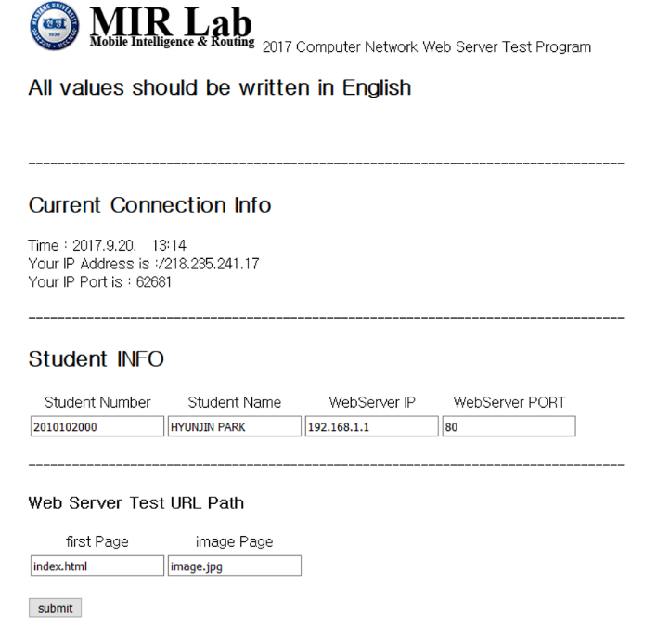
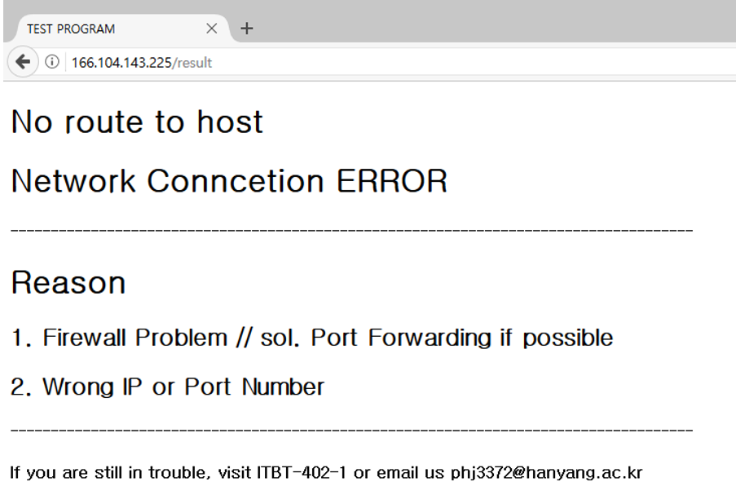
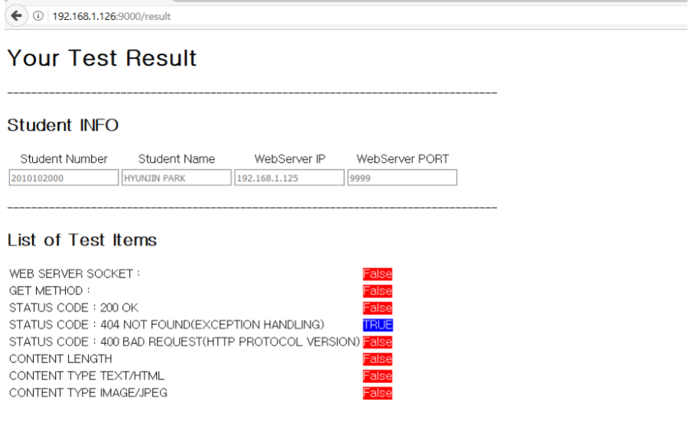
What to do? (2/2)
List of grading items
Mission 1: WEB SERVER SOCKET
Mission 2: GET METHOD
Mission 3: STATUS CODE : 200OK
Mission 4: STATUS CODE : 404 NOT FOUND(EXCEPTION HANDLING)
Mission 5: STATUS CODE : 400 BAD REQUEST(HTTP PROTOCOL VERSION )
Mission 6: CONTENT LENGTH
Mission 7: CONTENT TYPE TEXT/HTML
CONTENT TYPE IMAGE/JPEG
Notes:
Mission 1: WEB SERVER SOCKET
Mission 2: GET METHOD
Mission 3: STATUS CODE : 200OK
Mission 4: STATUS CODE : 404 NOT FOUND(EXCEPTION HANDLING)
Mission 5: STATUS CODE : 400 BAD REQUEST(HTTP PROTOCOL VERSION )
Mission 6: CONTENT LENGTH
Mission 7: CONTENT TYPE TEXT/HTML
CONTENT TYPE IMAGE/JPEG

Slide 5
Overview
Develop a multi-threaded web server that is capable of processing multiple simultaneous service request in parallel. The server code will be developed in two stages: 1. Write a multi-threaded server that simply displays the contents of the HTTP request message that it receives. 2. Add the code required to generate an appropriate response.
Demonstrate that the web server is capable of delivering your home page to a web browser. (Remember that you are not serving through the standard port 80 that you need to specify the port number within the URL that you give to your browser such as: http://home.someschool.edu:6789/index.html)

Slide 6
What is WebServer? (1/2)
Socket
a host-local, application-created, OS-controlled interface into which application process can both send and receive messages to/from another application process.
Socket: a door between application process and end-end-transport protocol (UCP or TCP)
TCP service: reliable transfer of bytes from one process to another
controlled by
application
developer
controlled by
application
developer
process
process
socket
socket
TCP with
buffers,
variables
TCP with
buffers,
variables
controlled by
operating
system
controlled by
operating
system
internet
host or
server
host or
server
Notes:
HTTP Protocol – Hypertext Transfer Protocol (Application)

Slide 7


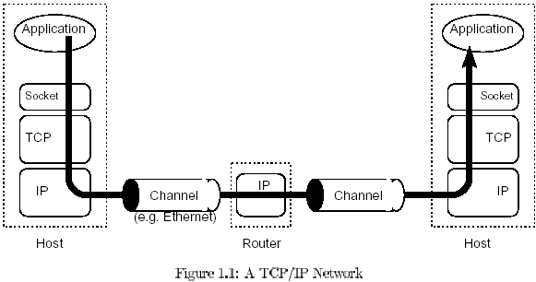
What is WebServer? (2/2)
Web server refers to server software, or hardware dedicated to running said software, that can serve contents to the World Wide Web. A web server processes incoming network requests over HTTP (Hypertext Transfer Protocol).
HTTP Client
Client
HTTP Programming
Server
HTTP Server
Ex) Internet Explorer,
Chrome, Safari, etc…
Ex) Apache, Engine X
API
Protocol
Notes:
HTTP Protocol – Hypertext Transfer Protocol (Application)

Slide 8
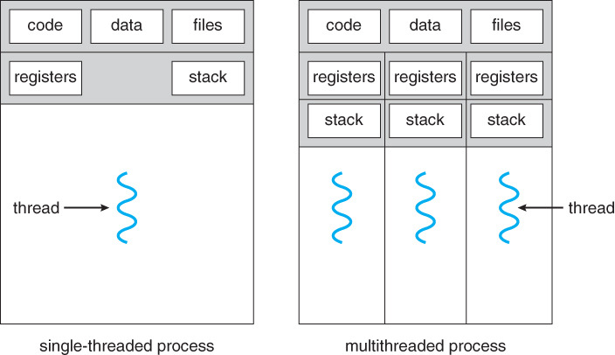
How do you make Multithread WebServer? (1/2)
A thread is a unit of execution (flow of performance) that uses the resources that the process is allocated to.
Multithread allows a program to perform multiple tasks at the same time.
Multithread Reason : The server creates a thread when one client comes in. If multi-threading is not possible, wait for the client to be terminated first. Therefore, it is necessary to create a multithreaded WebServer to serve each client.
User1
Request
User2
Request
User3
Request
Notes:
Multithread allows a program to perform multiple tasks at the same time. The reasons for multiparting in WebServer are as follows. The server creates a thread when one client comes in. If multi-threading is not possible, wait for the client to be terminated first. Therefore, it is necessary to create a multithreaded Web server to serve each client.

Slide 9
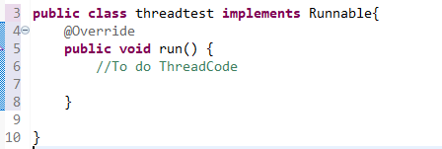
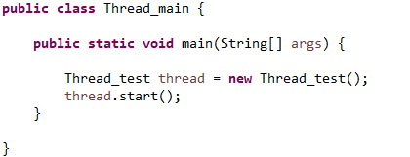
How do you make Multithread WebServer? (2/2)
How to make thread (Java)
Create a class that inherits the Thread class
Implements → Java Interface
Declare the thread claim inherited from the Main() function, then start
Notes:
HTTP Protocol – Hypertext Transfer Protocol (Application)

Slide 10
Overview of Web Server in Java
Web Server in Java
How to consist of Web Server
WebServer.Class
HttpRequest.Class
Protocol conformance
testing tool
Web Client
WebServer
HttpRequest
Create Socket(port)
Call Run()
Thread Start()
Send port number
socket
Call processRequest()
Define socket = this.socket
Protocol conformance testing Tool
object
New DataOutputStream()
Mission 1 ~ 8
object
New FileInputStream()
Input Parameter in method ( sendResponseMessage() )
sendResponseMessage()
Check Processing

Slide 11
Web Server in Java(1/8)
To allows the server to service multiple clients in parallel, or to perform multiple file transfers to a single client in parallel, the processing of each incoming request should take place inside a separate thread of execution
(In this case, we will define is as HttpRequest class)
We also need to pass an instance of a class to the thread’s constructor that implements the runnable interface.
We must make Two Class (WebServer, HttpRequest)

Slide 12
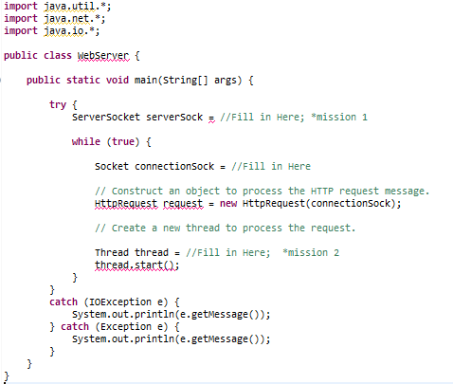
Web Server in Java(2/8)
WebServer.Class
Port: Use any port higher than 1024. Remember that you must use the same port number when making requests to your web server from your browser.
When a connection request is received, create an HttpRequest object and pass the socket object that represents our established connection to its constructor.
*Mission 1 : WEB SERVER SOCEKT
- The Web Server Socket should be open normally.
*Mission 2 : MULTI THREAD
- It should be implemented as Multi Thread.
Notes:
When a connection request is received, create an HttpRequest object and pass the socket object that represents our established connection to its constructor.
Open a socket and wait for a TCP connection request. Since we will servicing request messages indefinitely, place the listen operation inside an infinite loop.

Slide 13
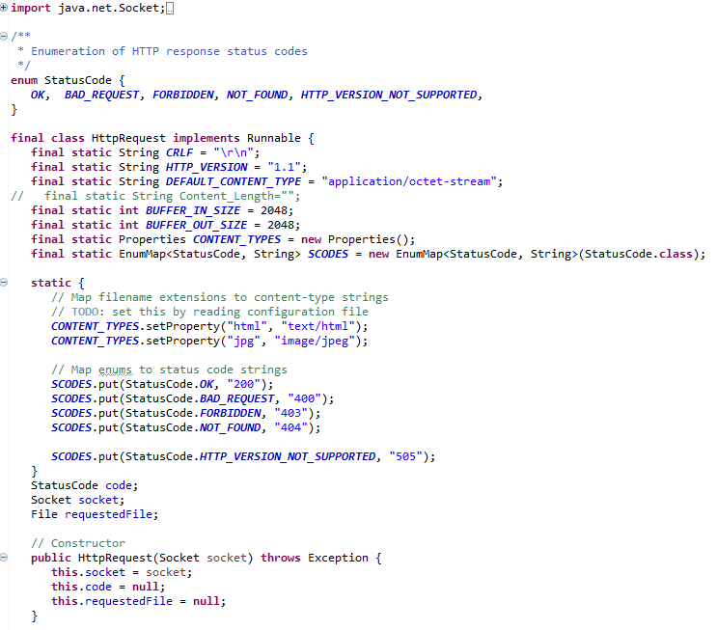
Web Server in Java(3/8)
HttpRequest.Class (Upgrade)
The CRLF variable consists of a carriage return(CR) and a line feed(LF) that is used to terminate each line of the server’s response message.
Request line
method
sp
URL
sp
Versoion
cf
lf
header field name:
sp
value
cf
lf
Header line
header field name:
sp
value
cf
lf
cf
lf
Blank line
Entity body
General format of an HTTP request message
Notes:
Declare two variables for the HttpRequest class: CRLF and socket.
The CRLF variable consists of a carriage return(CR) and a line feed(LF) that is used to terminate each line of the server’s response message.
The socket variable will be used to store a reference to the connection socket, which is passed to the constructor of this class.

Slide 14
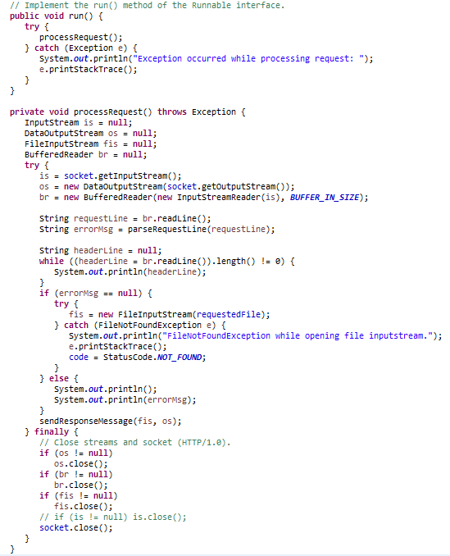
Web Server in Java(4/8)
HttpRequest.Class (Upgrade)
Thread Method Call and Start
WebServer.Class
HttpRequest.Class
Create Socket(port)
Call Run()
Thread Start()
Send port number
socket
Call processRequest()
Define socket = this.socket
object
New DataOutputStream()
File Input/OutputStream Create
If in case of InputStream,
Send this in buffer
A stream is a way to connect
a program with an I / O object
to send and receive data.
An InputStream is an object t
hat reads data, and an OutputStream
is an object that sends data.
object
New FileInputStream()
Input Parameter in method ( sendResponseMessage() )
sendResponseMessage()

Slide 15
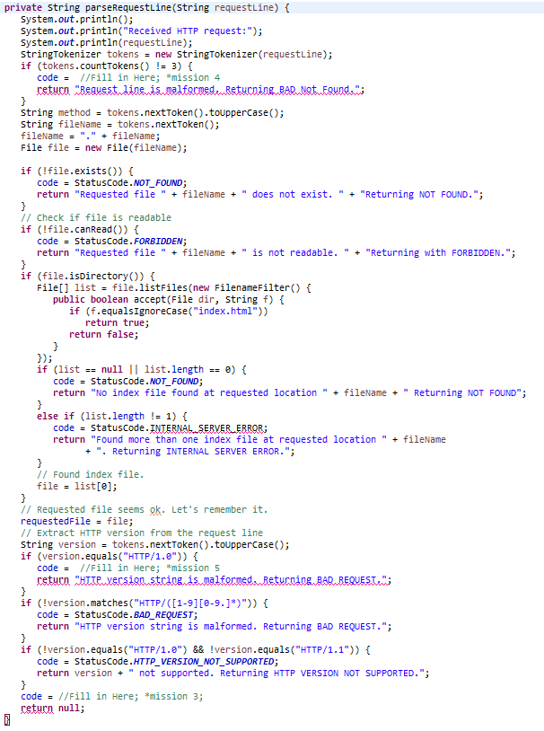
Web Server in Java(5/8)
HttpRequest.Class (Upgrade)
After displaying the browser’s http request message, we will analyze the request and send an appropriate response.
First, we should extract the file name from the request line with the aid of the StringTokenizer class.
(next page StringTokenizer API)
* Mission 3 : STATUS CODE 200 OK
- You should respond normally.
* Mission 4 : STATUS CODE 404 NOT FOUND(EXCEPTION HANDLING)
- You should be able to handle exceptions when sending to arbitrary paths.
* Mission 5 : STATUS CODE 400 NOT BAD REQUEST(HTTP PROTOCOL VERSION)
- When sending to HTTP version 1.0, it should be possible to make an incorrect response.
Notes:
Declare two variables for the HttpRequest class: CRLF and socket.
The CRLF variable consists of a carriage return(CR) and a line feed(LF) that is used to terminate each line of the server’s response message.
The socket variable will be used to store a reference to the connection socket, which is passed to the constructor of this class.

Slide 16
Web Server in Java(6/8)
StringTokenizer Class
source
String str = "1101,한송이,45,67,89,100";
StringTokenizer st = new StringTokenizer(str, ",");
String [] array = new String[st.countTokens()];
int i = 0;
while(st.hasMoreElements()){
array[i++] = st.nextToken();
}
for(i=0; i < array.length ; i++){
System.out.println(array[i]);
}
StringTokenizer Class for truncating strings.
Introduces two popular constructors in StringTokenizer.
For more in-depth instructions, see api (see Java API for the rest).
StringTokenizer (String str)
Creates a tokenizer object for truncating a str string.
Cut the string based on 'space bar' because you do not fill in the criteria to cut.
StringTokenizer (String str, String split)
Creates a tokenizer object for truncating the str string.
Cuts characters based on the string entered in split.
The base character is destroyed in the string.
Here are three of the most frequently used methods.
countTokens ()
Returns the number of tokens that the string will have as a result of truncation. I can see how many are cut off.
Strng nextToken ()
Tokenizer receives sequential tokens through the next token. Cut one token from the front. The next time nextToken () returns the next string in the string received this time.
boolean hasMoreElements ()
Check if there are more tokens to receive in the current tokenizer.
(StringTokenizer api address:
https://docs.oracle.com/javase/8/docs/api/index.html?java/util/StringTokenizer.html)
Notes:
When a connection request is received, create an HttpRequest object and pass the socket object that represents our established connection to its constructor.
Open a socket and wait for a TCP connection request. Since we will servicing request messages indefinitely, place the listen operation inside an infinite loop.

Slide 17
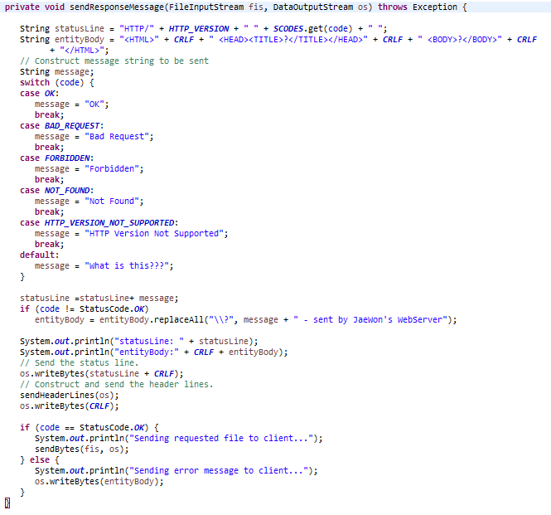
Web Server in Java(7/8)
HttpRequest.Class (Upgrade)
Since we have the file name, open the file and if it does not exist, the FileInputStream(), DataOutputStream() constructor will throw the FileNotFoundException and terminating the thread.
Notes:
Declare two variables for the HttpRequest class: CRLF and socket.
The CRLF variable consists of a carriage return(CR) and a line feed(LF) that is used to terminate each line of the server’s response message.
The socket variable will be used to store a reference to the connection socket, which is passed to the constructor of this class.

Slide 18
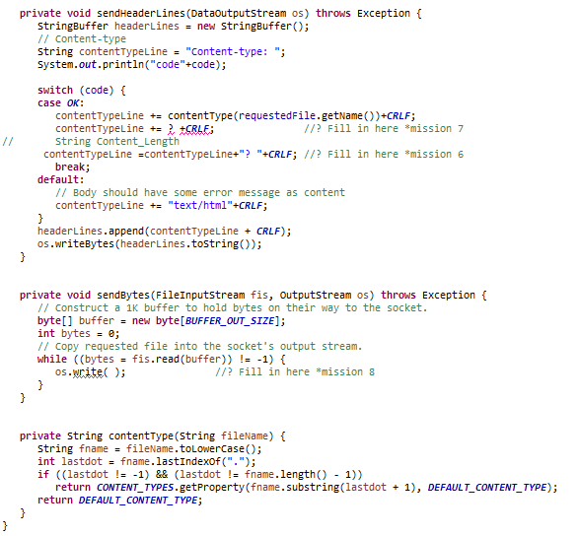
Web Server in Java(8/8)
HttpRequest.Class (Upgrade)
* Mission 6 : CONTENT LENGTH
- You have to set size of 1024 of data
* Mission 7 : CONTENT TYPE TEXT/HTML
- You should be able to send the content type as text.
* Mission 8 : CONTENT TYPE IMAGE/JPEG
- You should be able to send the content type as image
Notes:
Declare two variables for the HttpRequest class: CRLF and socket.
The CRLF variable consists of a carriage return(CR) and a line feed(LF) that is used to terminate each line of the server’s response message.
The socket variable will be used to store a reference to the connection socket, which is passed to the constructor of this class.

Slide 19


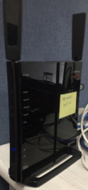
Port forwarding (1/2)
Port forwarding or port mapping is a network address that transfers communication requests from one IP address and port number combination to another while packets traverse network gateways such as routers or firewalls in a computer network.
Check : ipconfig
192.168……
It is local Ip
Do no need to port forwarding
Students
Need to Port Forwarding
Notes:
Testing Factors of Web Server Test
Mission 1 : WEB SERVER SOCEKT
- Web Server Socket 이 정상적으로 열려있어야 한다.
Mission 2 : MULTI THREAD
- Multi Thread 형태로 구현되어야 한다.
Mission 3 : STATUS CODE 200 OK
- 정상적으로 응답을 해야한다.
Mission 4 : STATUS CODE 400 NOT FOUND(EXCEPTION HANDLING)
- 임의의 경로로 보냈을 때 예외처리를 할 수 있어야 한다.
Mission 5 : STATUS CODE 400 NOT BAD REQUEST(HTTP PROTOCOL VERSION)
- HTTP1.0버전으로 전송할 때 올바른 응답을 할 수 있어야 한다.
Mission 6 : CONTENT LENGTH
- 데이터는 1024로 크기를 고정한다.
Mission 7 : CONTENT TYPE TEXT/HTML
- Content type을 text로 보낼 수 있어야 한다.
Mission 8 : CONTENT TYPE IMAGE/JPEG
- Content type을 image로 보낼 수 있어야 한다.

Slide 20
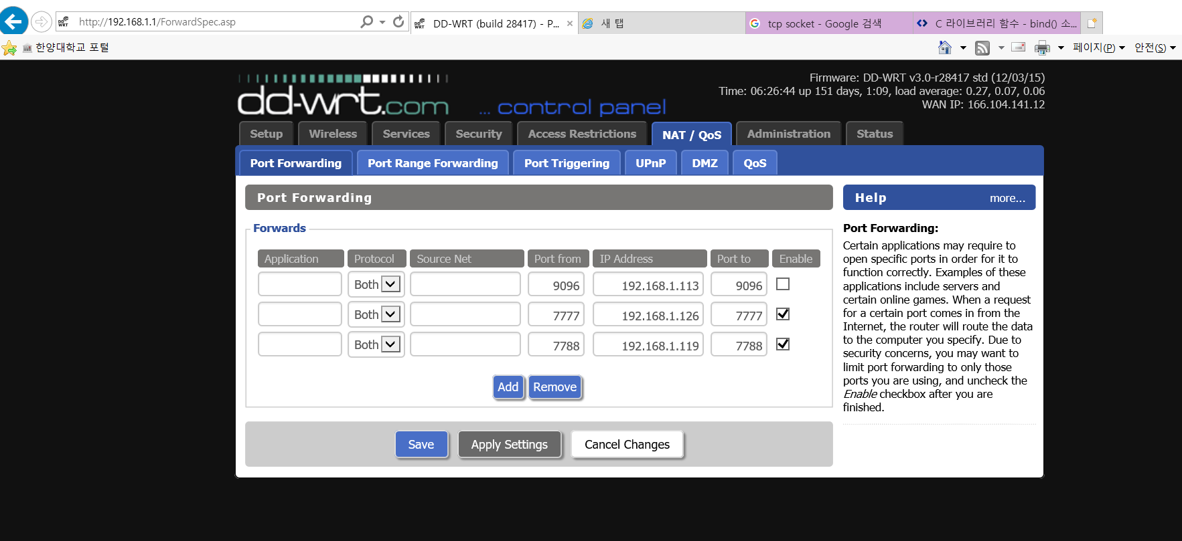
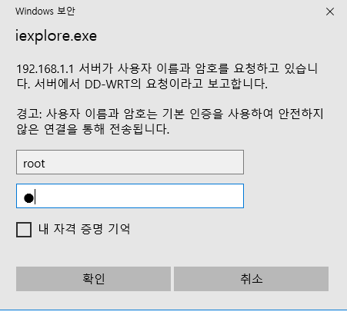
Port forwarding (2/2)
How to configure Port forwarding. It is different for each router. Therefore, each person should access the network and then do port forwarding.
Notes:
Testing Factors of Web Server Test
Mission 1 : WEB SERVER SOCEKT
- Web Server Socket 이 정상적으로 열려있어야 한다.
Mission 2 : MULTI THREAD
- Multi Thread 형태로 구현되어야 한다.
Mission 3 : STATUS CODE 200 OK
- 정상적으로 응답을 해야한다.
Mission 4 : STATUS CODE 400 NOT FOUND(EXCEPTION HANDLING)
- 임의의 경로로 보냈을 때 예외처리를 할 수 있어야 한다.
Mission 5 : STATUS CODE 400 NOT BAD REQUEST(HTTP PROTOCOL VERSION)
- HTTP1.0버전으로 전송할 때 올바른 응답을 할 수 있어야 한다.
Mission 6 : CONTENT LENGTH
- 데이터는 1024로 크기를 고정한다.
Mission 7 : CONTENT TYPE TEXT/HTML
- Content type을 text로 보낼 수 있어야 한다.
Mission 8 : CONTENT TYPE IMAGE/JPEG
- Content type을 image로 보낼 수 있어야 한다.

Slide 21
Protocol conformance testing tool (1/4)
Testing Factors of Web Server Test
Mission 1 : WEB SERVER SOCEKT
- The Web Server Socket should be open normally.
Mission 2 : MULTI THREAD
- It should be implemented as Multi Thread.
Mission 3 : STATUS CODE 200 OK
- You should respond normally.
Mission 4 : STATUS CODE 404 NOT FOUND(EXCEPTION HANDLING)
- You should be able to handle exceptions when sending to arbitrary paths.
Mission 5 : STATUS CODE 400 NOT BAD REQUEST(HTTP PROTOCOL VERSION)
- When sending to HTTP version 1.0, it should be possible to make an incorrect response.
Mission 6 : CONTENT LENGTH
- You have to set size of 1024 of data
Mission 7 : CONTENT TYPE TEXT/HTML
- You should be able to send the content type as text.
Mission 8 : CONTENT TYPE IMAGE/JPEG
- You should be able to send the content type as image
Notes:
Testing Factors of Web Server Test
Mission 1 : WEB SERVER SOCEKT
- Web Server Socket 이 정상적으로 열려있어야 한다.
Mission 2 : MULTI THREAD
- Multi Thread 형태로 구현되어야 한다.
Mission 3 : STATUS CODE 200 OK
- 정상적으로 응답을 해야한다.
Mission 4 : STATUS CODE 400 NOT FOUND(EXCEPTION HANDLING)
- 임의의 경로로 보냈을 때 예외처리를 할 수 있어야 한다.
Mission 5 : STATUS CODE 400 NOT BAD REQUEST(HTTP PROTOCOL VERSION)
- HTTP1.0버전으로 전송할 때 올바른 응답을 할 수 있어야 한다.
Mission 6 : CONTENT LENGTH
- 데이터는 1024로 크기를 고정한다.
Mission 7 : CONTENT TYPE TEXT/HTML
- Content type을 text로 보낼 수 있어야 한다.
Mission 8 : CONTENT TYPE IMAGE/JPEG
- Content type을 image로 보낼 수 있어야 한다.

Slide 22
Protocol conformance testing tool (2/4)
Flow of Web Server Test
Students
HTTP Server
HTTP Client
Mysql Database
Visit Website
166.104.143.225/index.html
GET Method
Testing Factors
Response
Index.html
HTTP/1.1 200 OK
Mission 1 : WEB SERVER SOCEKT
- The Web Server Socket should be open normally.
Mission 2 : MULTI THREAD
- It should be implemented as Multi Thread.
Mission 3 : STATUS CODE 200 OK
- You should respond normally.
Mission 4 : STATUS CODE 404 NOT FOUND(EXCEPTION HANDLING)
- You should be able to handle exceptions when sending to arbitrary paths.
Mission 5 : STATUS CODE 400 NOT BAD REQUEST(HTTP PROTOCOL VERSION)
- When sending to HTTP version 1.0, it should be possible to make an incorrect response.
Mission 6 : CONTENT LENGTH
- You have to set size of 1024 of data
Mission 7 : CONTENT TYPE TEXT/HTML
- You should be able to send the content type as text.
Mission 8 : CONTENT TYPE IMAGE/JPEG
- You should be able to send the content type as image
Input Student Information
166.104.143.225/index.html
POST Method
Start HTTP Client Thread
to check Student Server
based on Student Info
Result Page
that if How Student Server
Woks(error or correct)
Check Processing
Response
Result(Show Result Page)
HTTP/1.1 200 OK
Execute query Student
Test Result to save

Slide 23
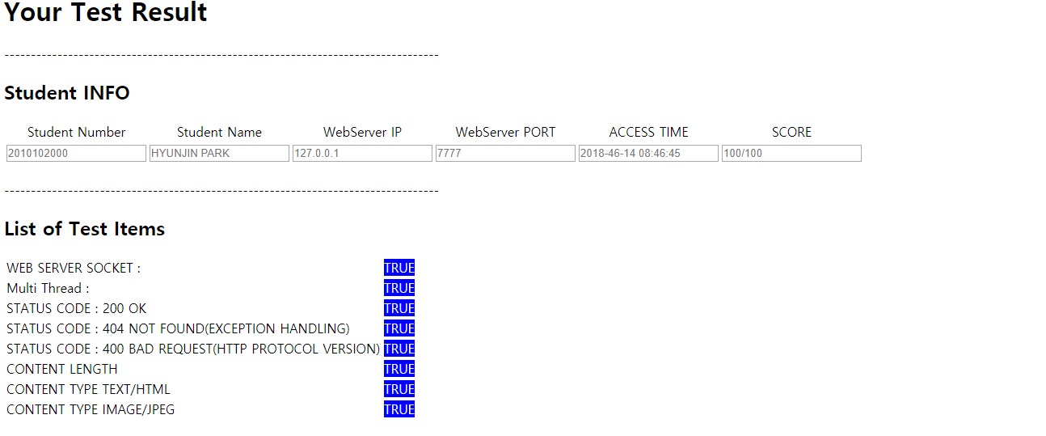
Protocol conformance testing tool (3/4)
Result page - 1
Success page

Slide 24
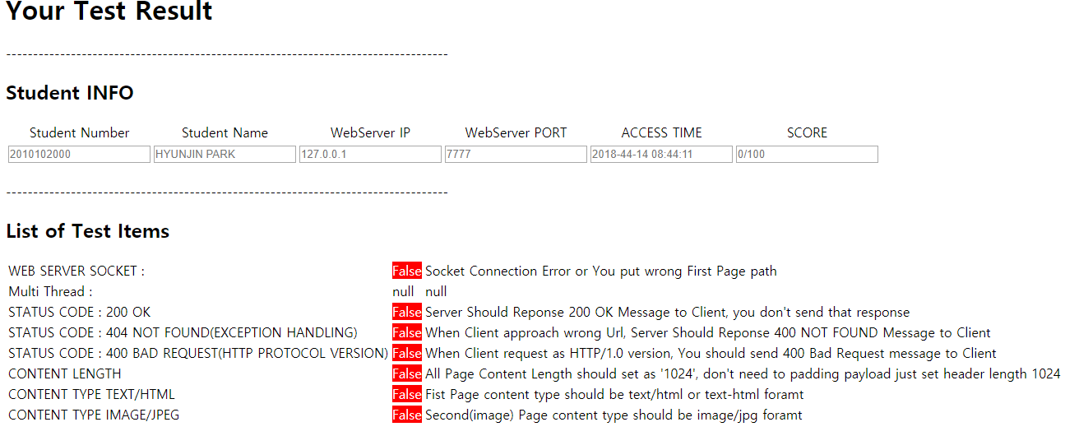
Protocol conformance testing tool (4/4)
Result page - 2
Failed page

Slide 25
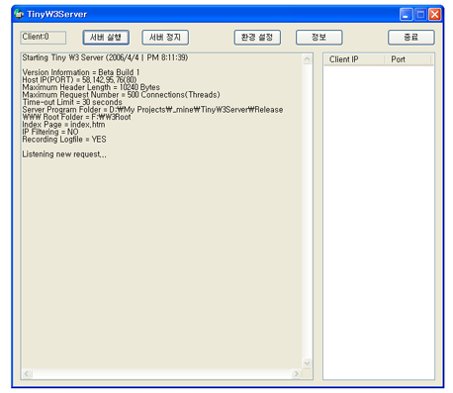
DEMO _C++ Language (1/2)
WebServer
Function | explanation
HTTP/1.0(1.1) | Supports HTTP/1.0 and 1.1.
IE, Mozilla Compatible | Fully compatible with MS Internet Explorer, Mozilla browser for Linux.
Multithreaded Based | UI / Response thread / Requested thread disconnected.
GET / POST | Accept GET / POST requests in both ways.
Multiple File Handling | Process html, xml, jpeg, bitmap, gif, swf. All other files can be transferred to binary files for download by the user.
Login Functions | Specify a secure folder to allow access only upon login. (Use Session Cookies)
IP Blocking | Block IPs in the Block List.
Specify Web Root | You can specify the folder to use as the root of the web server.
Specifying the default page | Only request path without page name Ex)URL:http://127.0.0.1/publlic -> http://127.0.0.1/public/index.htm
Variable Port | You can specify a variable lease port for a Web server
Timeout | If the connection is maintained but there is no response, the connection is automatically disabled if the specified time is exceeded.
Creating a log file | In addition to printing logs on the screen, you can also create logs as files.
Client Information | Shows the number of connected clients / individual IPs and ports in real time.
Redirection | 404 error. If a login fails, it will be redirected to the information page.
Server Environment Settings | You can change options by modifying the preferences file without compiling. ▪Web Server Folder ▪Default page name ▪Listening Port ▪Timeout ▪IP Block use status ▪Log File Creation status ▪Block IP List ▪Register Security Folders and Accounts(ID,PW)

Slide 26
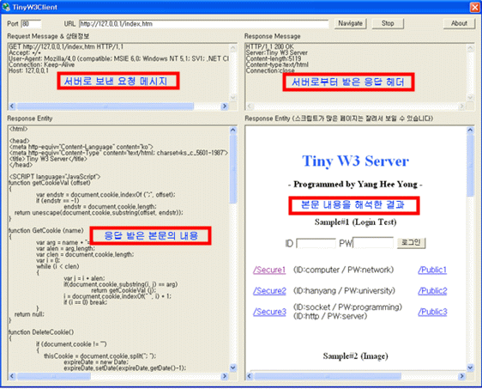
DEMO _C++ Language (2/2)
WebClient
Function | explanation
HTTP/1.1 | Works with HTTP 1.1 protocol.
Multithreaded Based | The UI and Communication thread are disconnected, Allowing asynchronous commands.
Interpreting Chunked Code | Allows interpretation of Chunked encoded content.
Multiple File Handling | Process html, xml, jpeg, bitmap, gif, and swf files. Download other files.
Graphic Output | Prints downloaded pictures and flash movie
Domain Name Analysis | Automatically switches the domain name of the letter to IP to connect.
Specify Connection Port | You can specify the server-side leasing port..
Redirection processing | Perform redirection Processing for 302 Response on the Server
Auto-Convert Addresses | If a user enters without http:// or sends a redirect response from the server to the relative path, the absolute path is calculated and displayed in the address bar.

Slide 27
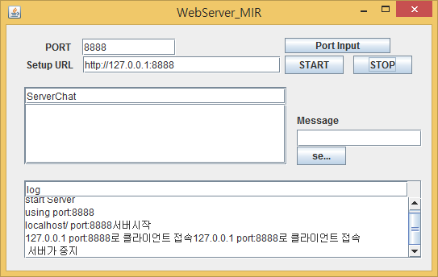
DEMO _Java Language (1/2)
WebServer
Function | explanation
HTTP/1.0(1.1) | Supports HTTP/1.0 and 1.1.
Multithreaded Based | UI / Response thread / Requested thread disconnected.
GET / POST | Accept GET / POST requests in both ways.
Specifying the default page | Only request path without page name Ex)URL:http://127.0.0.1/publlic -> http://127.0.0.1/public/index.htm
Variable Port | You can specify a variable lease port for a Web server
Timeout | If the connection is maintained but there is no response, the connection is automatically disabled if the specified time is exceeded.
Client Information | Shows the number of connected clients / individual IPs and ports in real time.
Redirection | 404 error. If a login fails, it will be redirected to the information page.
Functionality Client and Chat Not Implemented

Slide 28
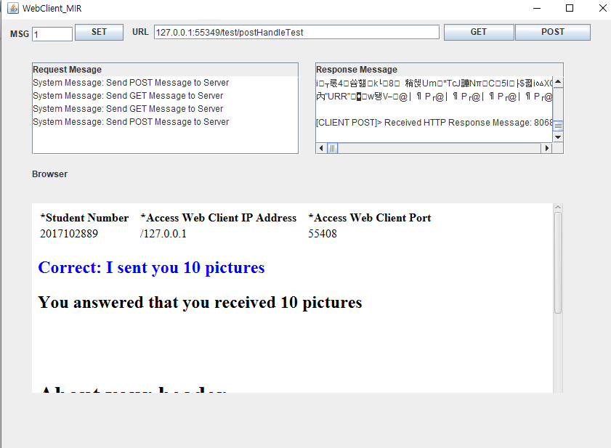
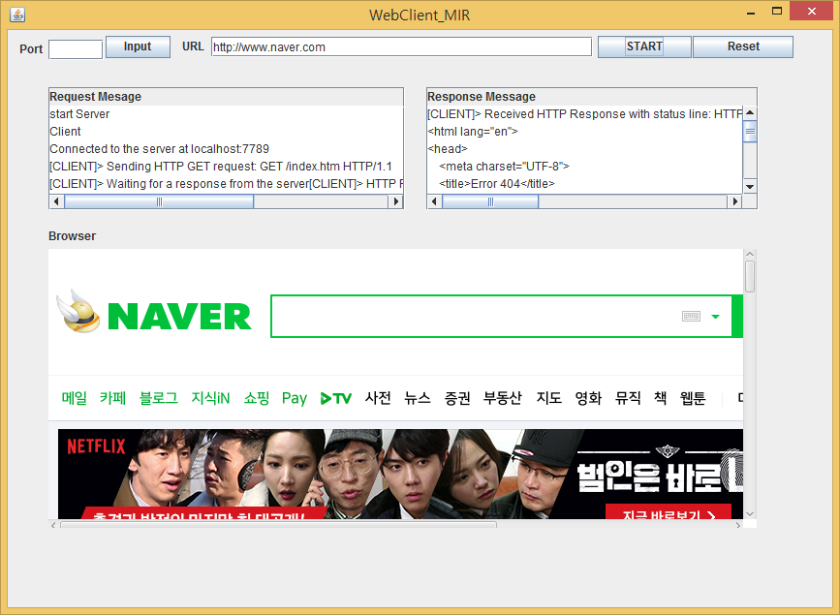
DEMO _Java Language (2/2)
Web Client
Function | explanation
HTTP/1.1 | Works with HTTP 1.1 protocol.
Multithreaded Based | The UI and Communication thread are disconnected, Allowing asynchronous commands.
WebView | You can view Web for Web Client
Domain Name Analysis | Automatically switches the domain name of the letter to IP to connect.
Auto marking System | You can Check Auto Marking System for MSG(Message)
Redirection processing | Perform redirection Processing for 302 Response on the Server
Get/Post | Send GET / POST requests in both ways.

Slide 29
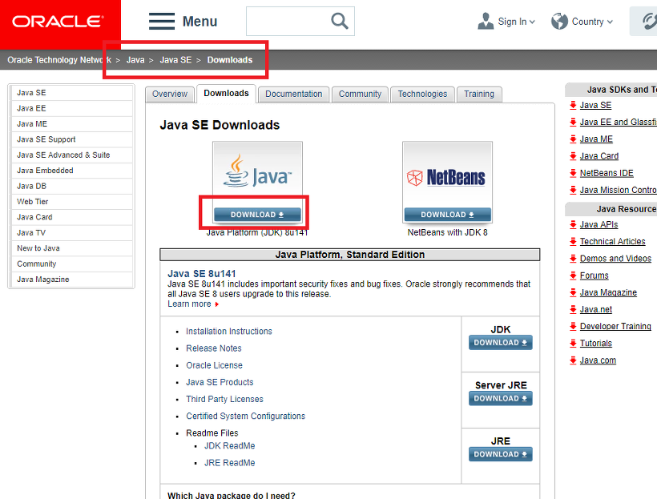
Appendix _Window Java Install
1. JDK Install
[JAVA JDK Download]
http://www.oracle.com/technetwork/java/javase/downloads/index-jsp-138363.html

Slide 30
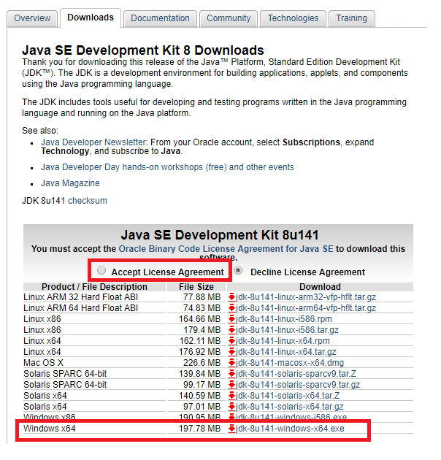
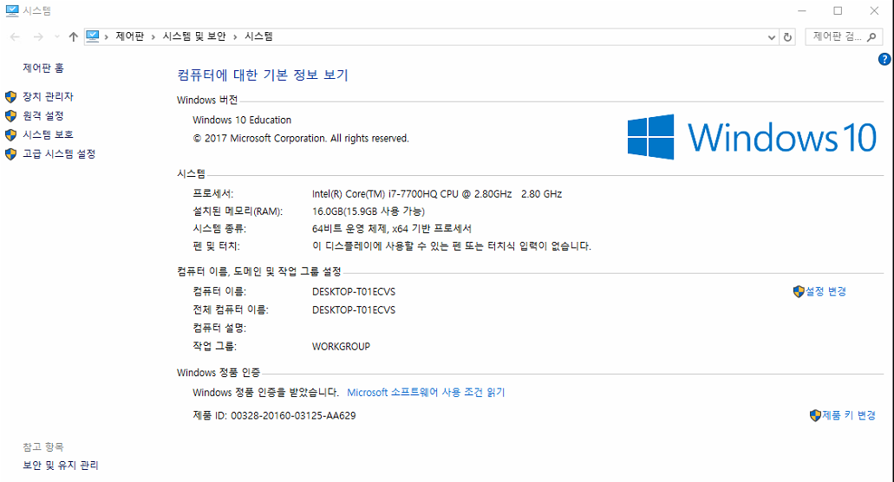
Appendix _Window Java Install
JDK Install
You can install it according to your OS environment. How to check my computer or My PC -> Right click on the mouse properties and check the system part

Slide 31
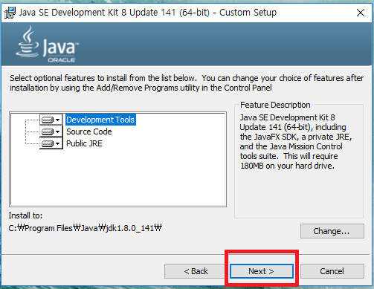
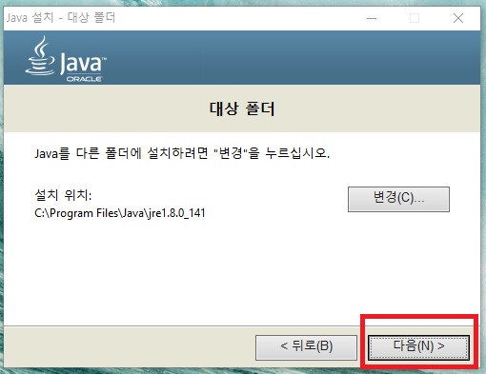
Appendix _Window Java Install
JDK Install
Next Button

Slide 32
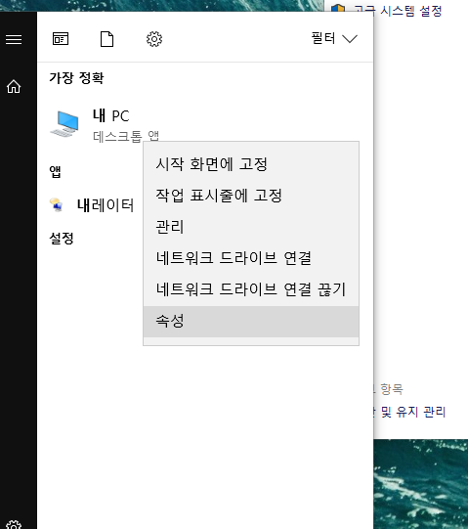
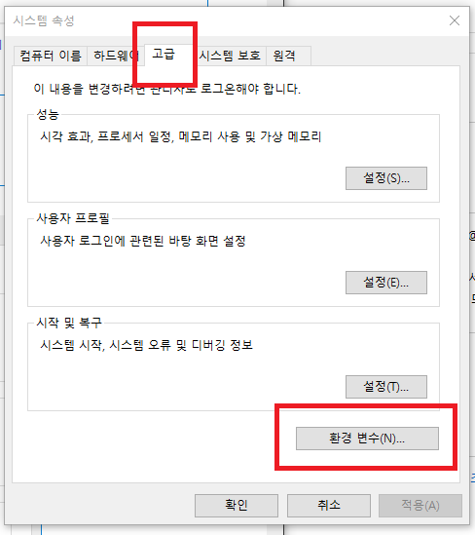
Appendix _Window Java Install
JDK Install _ Environment Variables
If you do not specify a path specifically, Java jdk and jre will be installed in C: \ Program Files \ Java path.
Now let's get the environment variables. (If your Computer is Window 10, don’t have to point environment variables.

Slide 33
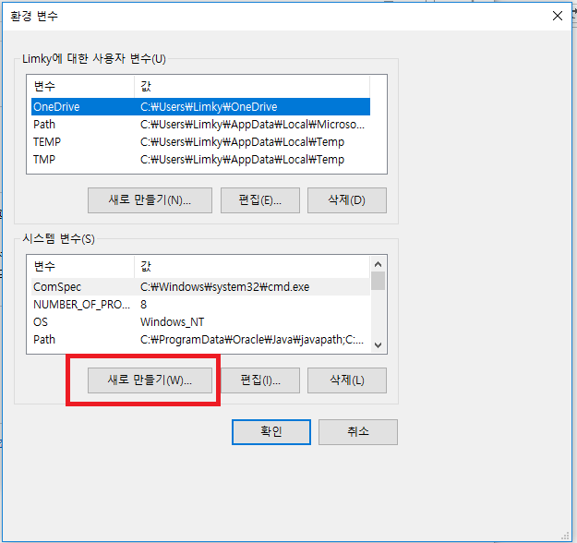
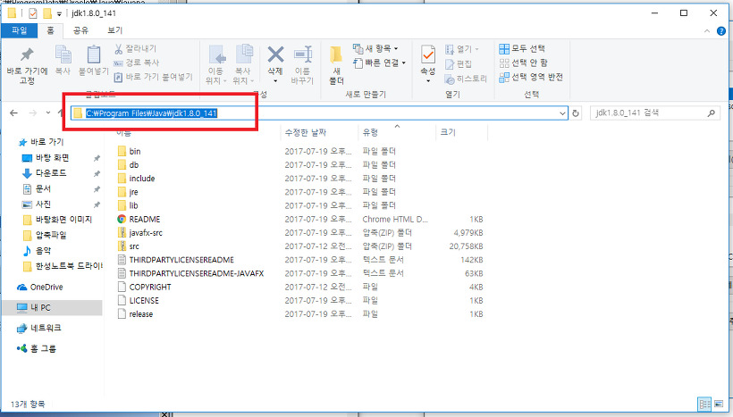
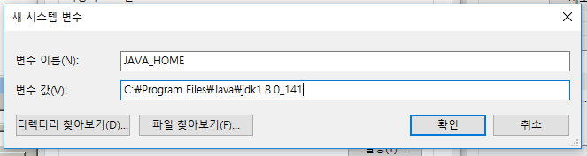
Appendix _Window Java Install
JDK Install _ Environment Variables
Java Path Copy and Paste environment variables.

Slide 34
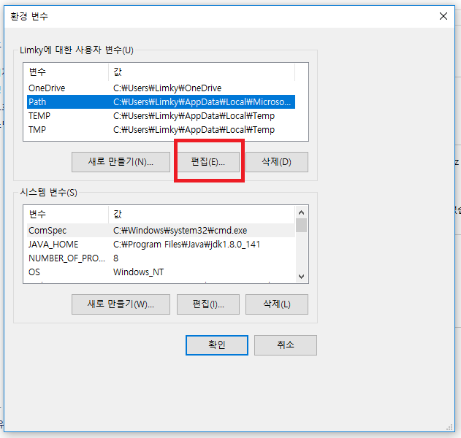
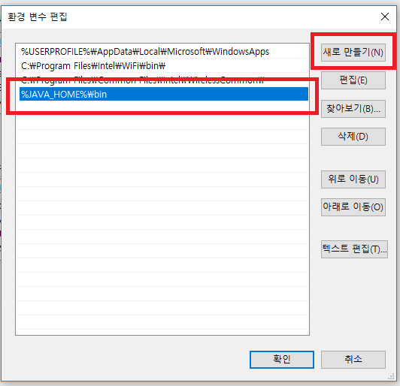
Appendix _Window Java Install
JDK Install _ Environment Variables
Edit Button Click and Add New %JAVA_HOME%bin

Slide 35
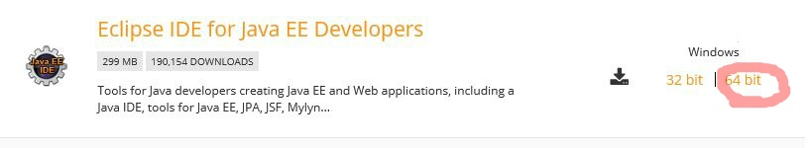
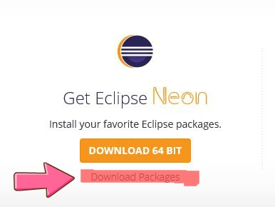
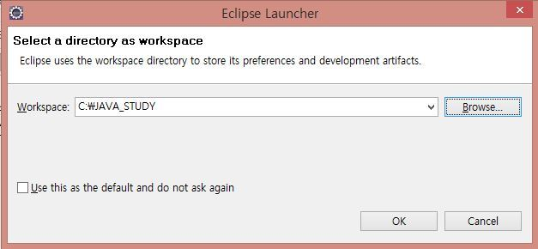
Appendix _Window Java Install
2. Eclipse Install
Now that you have installed Java, you should download the eclipse editor which will use java.
http://www.eclipse.org/downloads/

Slide 36
Appendix _Linux Java Install
1. JDK Install – A
How to install JDK at one time using terminal
Install Oracle Java in terminal
sudo apt-get install software-properties-common -y && \ sudo add-apt-repository ppa:webupd8team/java -y && \ sudo apt-get update && \ echo "oracle-java8-installer shared/accepted-oracle-license-v1-1 select true" | sudo debconf-set-selections && \ sudo apt-get install oracle-java8-installer oracle-java8-set-default -y
Note:
If this is not the run , use Method B.

Slide 37
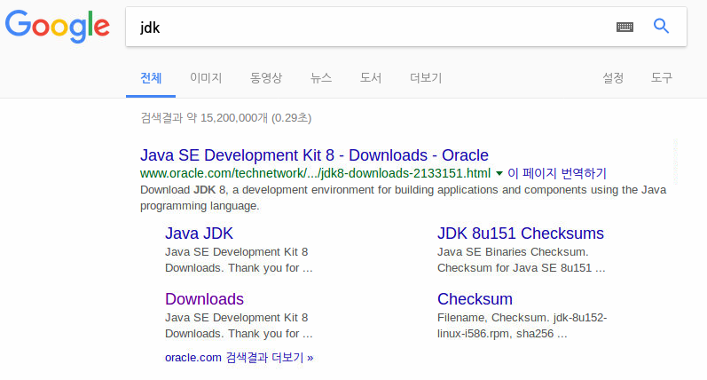
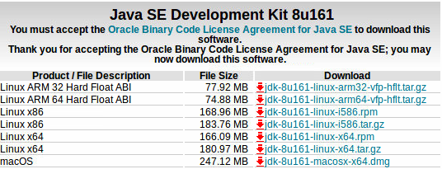
Appendix _Linux Java Install
1. JDK Install – B (1/3)
JDK installation progress
Download the JDK for your OS.
Note: JDK version 8, the number after u does not matter

Slide 38
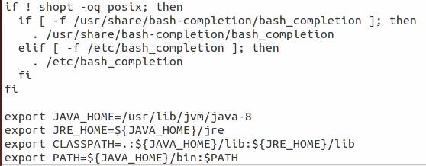
Appendix _Linux Java Install
1. JDK Install – B (2/3)
Environment variable registration process after downloading JDK
Install Oracle Java 1.8
$ sudo mkdir -p /usr/lib/jvm $ sudo mv jdk-8u161-linux-x64.tar.gz /usr/lib/jvm $ cd /usr/lib/jvm $ sudo tar xzvf jdk-8u161-linux-x64.tar.gz $ sudo ln -s jdk1.8.0_11 java-8 $ gedit ~/.bashrc

Slide 39
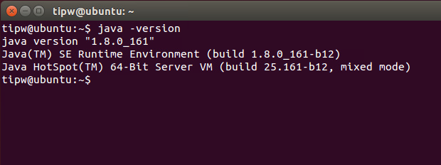
Appendix _Linux Java Install
1. JDK Install – B (3/3)
If environment variable registration is completed, proceed to the next step.
source ~/.bashrc java -version
You can check whether the setting is completed by using java -version.

Slide 40
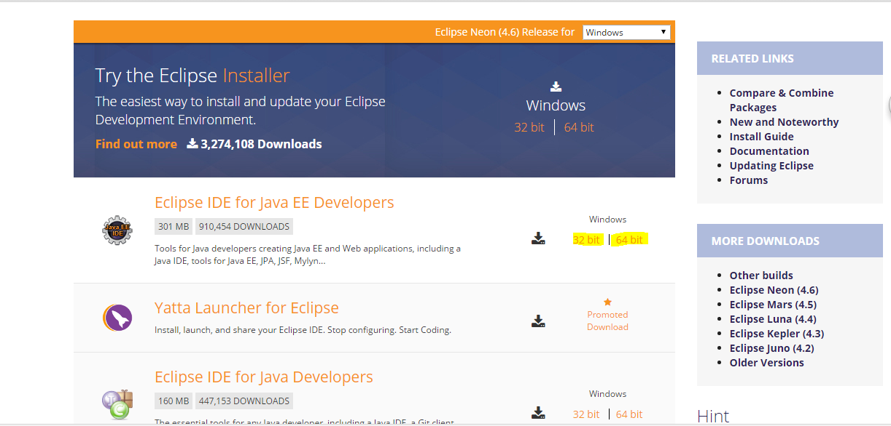
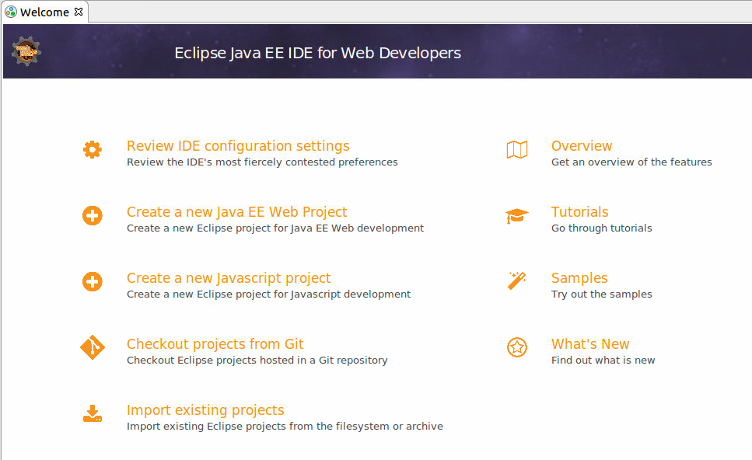
Appendix _Linux
Java Install
2. Eclipse Install
Install git and git-core
$ sudo apt-get install git $ sudo apt-get install git-core
1. Install Git
Download Eclipse IDE for Java EE developer
https://eclipse.org/downloads/eclipse-packages/
2. Run downloaded program
run

